Slide 1
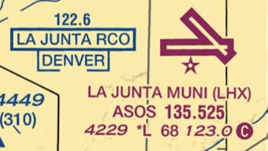
Chart Symbology
Q
What is this?

Slide 2
Chart Symbology
This is an RCO (remote communications outlet) for FSS. The frequency is 122.6 and it is co-located at KLHX. The callsign you would use to call this FSS is “Denver Radio.”

Slide 3
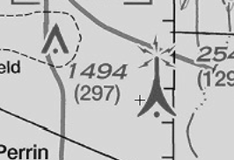
Chart Symbology
Q
Here are two towers on a VFR chart. The symbols are different. What is the difference between these towers?

Slide 4
Chart Symbology
The larger tower symbol depicts a tower 1,000 ft AGL or higher. The smaller symbol depicts a tower under 1,000 ft AGL.

Slide 5
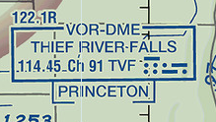
Chart Symbology
Q
You want to contact FSS. What frequency will you use?

Slide 6
Chart Symbology
Notice the “R” next to 122.1? Also notice 114.45 (the VOR frequency) is not underlined. This means the VOR frequency is voice capable. We’ll use 122.1 to contact “Princeton Radio.”
However, FSS can only receive on 122.1 but they will transmit on 114.45. So we need to tune in 114.45 on the NAV radio, and select NAV on the audio panel. Bottomline, we’ll talk to FSS through 122.1 but we’ll listen to their reply on the VOR frequency of 114.45.

Slide 7
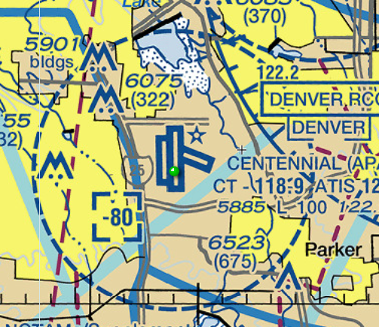

Chart Symbology
Q
What is the
symbol depicting?

Slide 8

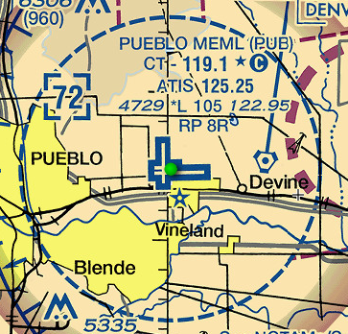
Chart Symbology
The Centennial Class D airspace sits under a Class B shelf. The Class D goes up to but does not include 8,000 MSL.
The Bravo shelf in this area goes down to 8,000 MSL.
The Class D airspace at KPUB does not sit under a shelf; it is a stand-alone Delta. So the symbol is missing the hyphen (or minus sign). This means the Class D goes up to and INCLUDES 7,200 MSL.

Slide 9
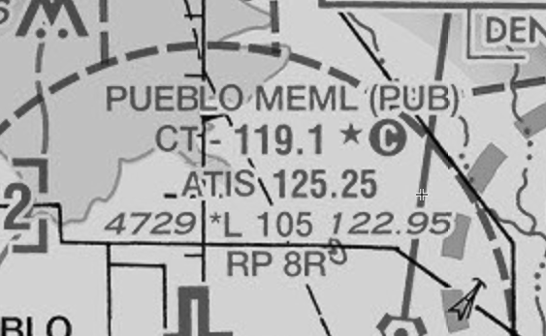
Chart Symbology
Q
What does this star represent?

Slide 10
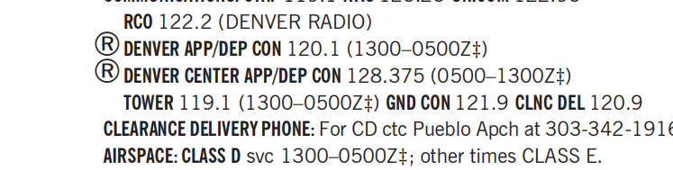
Chart Symbology
This means the KPUB control tower is part time. To see its operating hours, refer to the chart supplement.

Slide 11
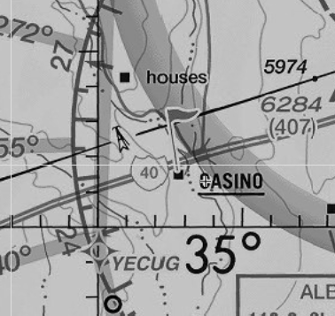
Chart Symbology
Q
What is this flag symbol?

Slide 12
Chart Symbology
It is a VFR checkpoint. Sometimes called a reporting point. If there is an underlined name nearby, it is the name of the checkpoint. In this case this checkpoint is called “Casino.”

Slide 13
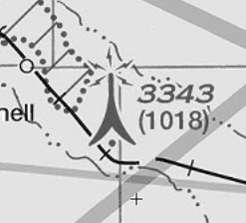
Chart Symbology
Q
What are these lightning bolt symbols on this tower?

Slide 14
Chart Symbology
The lightning bolts tell us the tower has strobe lights and/or night lighting.

Slide 15
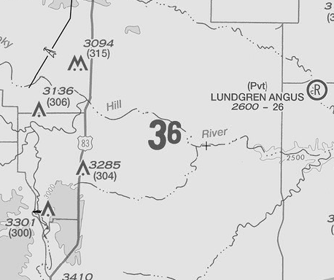
Chart Symbology
Q
What does the “36” mean?

Slide 16
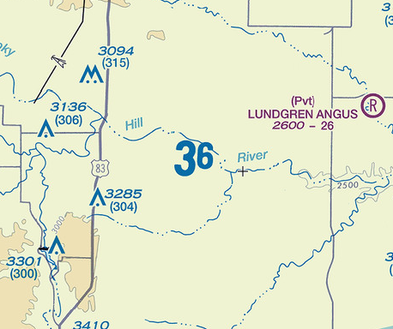
Chart Symbology
This is the maximum elevation figure (MEF) for this quadrant.
The MEF is the highest elevation (terrain + any obstructions) within the quadrangle, rounded up, to the next 100 feet.

Slide 17
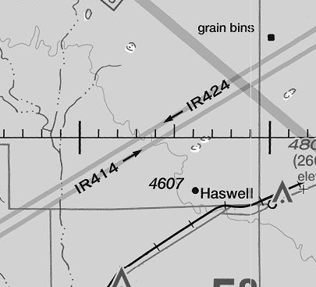
Chart Symbology
Q
What are these?

Slide 18
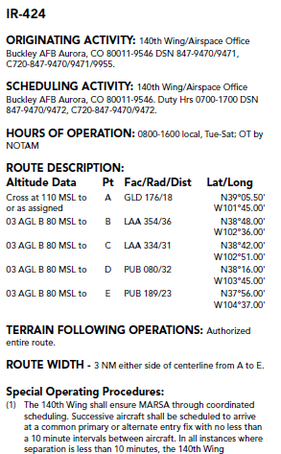
Chart Symbology
These are one of two types of MTRs (military training routes). These are IR (instrument routes) the other type is VR (visual route). They are predesignated corridors for military low-level training.
Routes at or below 1500’ AGL (with no segment above 1500’) are identified by four-digit numbers; e.g., VR1007, etc. These routes are generally developed for flight under VFR.
Routes above 1500’ AGL (some segments of these routes may be below 1500’) are identified by three or fewer digit numbers; e.g., IR21, VR302, etc. These routes are developed for flight under IFR.
To the right is the published data on IR-424.

Slide 19
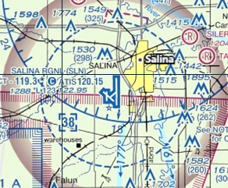
Chart Symbology
Q
You are flying your homebuilt across the state at high noon. You have no electronics on board. You are headed straight for KSLN. What do you need to do?

Slide 20
Chart Symbology
A review of the chart supplement shows that KSLN tower is open everyday at noon therefore, the Class D airspace is active. As a result, you must avoid it by flying around it or over it (above 3,800 MSL).

